Slide 1
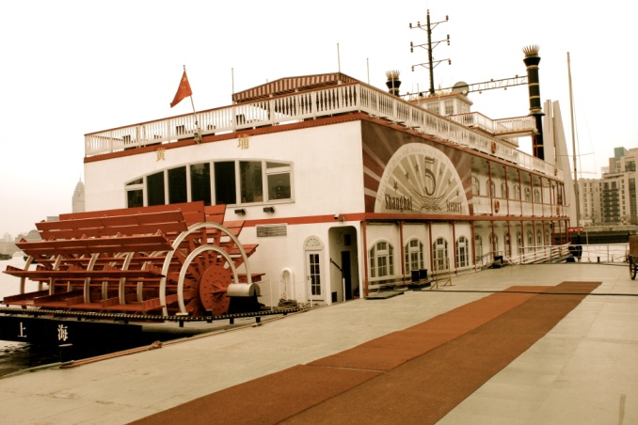
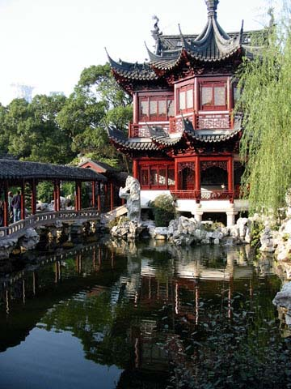
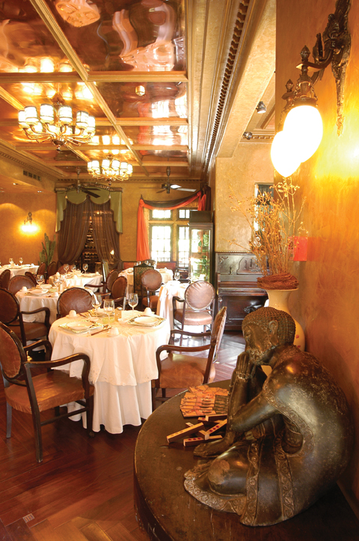
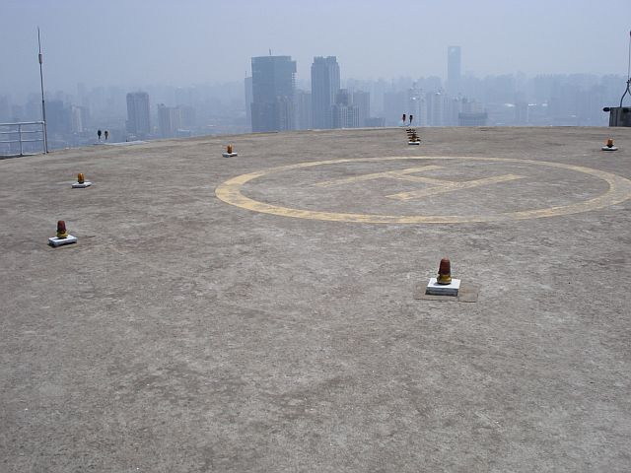
EVENT LOCATIONS IN CHINA
There are many locations in China outside the popular event destinations of Shanghai and Beijing suitable for MICE events. Cities like Xiamen or Lijiang might be perfect choices for organising corporate meetings, incentive travel and other events. Moreover, locations like these are rich in culture, which could add some local flavour to your event.

Slide 2
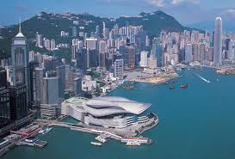
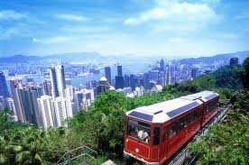
HONG KONG
Situated on China’s south coast and enclosed by Pearl River Delta and South China Sea, Hong Kong is renowned for its expansive skyline and deep natural harbour. With over 100 years of colonial history and a largely Chinese population, the city is a unique fusion of Western and Eastern cultures where the old and the new live side by side. Its incense-filled temples, colonial buildings and glass-and-steel skyscrapers, along with its ancient traditions and lively festivals, have made Hong Kong a living culture experience.
World-class facilities in locations like Asia World-Expo, Sky Plaza Retail or JW Marriott Hotel provide excellent platforms for international conferences, incentive and corporate functions and exhibitions.
Among recommended venues are also restaurants atop The Peak with spectacular views over the city or an event in the Hong Kong Disneyland resort. There are also possibilities to organise exclusive cruises around Hong Kong’s islands with unforgettable dining experiences.

Slide 3
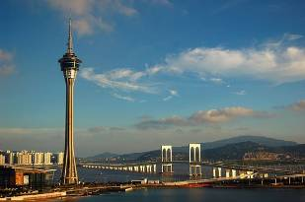
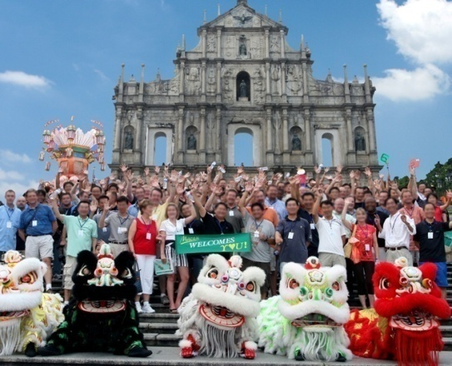
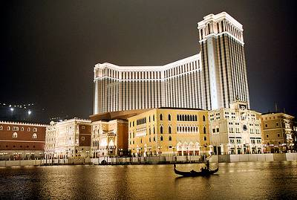
MACAU
The Historic Centre of Macau, officially listed as a UNESCO World Cultural Heritage site ,is the oldest, the most complete and consolidated array of European architectural legacy standing intact on Chinese territory. Most sites retain their original function and spirit to the present day.
Macau is also called Asia’s Las Vegas with many casinos and luxurious venues which make the city a MICE heaven.
A very unique location is Macau Tower - the world’s highest ‘skyjump’ tower with fantastic views over the city and surrounding islands, all enhanced by the 360º revolving structure. Other recommended venues are: The Venetian Resort, Grand Lisboa, MGM Grand , Hotel Lisboa, Sands Macao. Macao is also only a short boat or helicopter ride away from Hong Kong and a great sightseeing destination for your MICE itinerary.

Slide 4
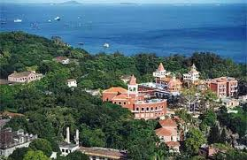
XIAMEN
Xiamen is a coastal city in southeastern China in Fujian province. It was recently voted China's cleanest city. Xiamen and its surrounding countryside provide spectacular scenery and pleasant tree-lined beaches.
Gulangyu, also known as Piano Island, is a popular, peaceful getaway with amazing views of the city and features many Victorian-era style European edifices.
Xiamen offers opportunities for unforgettable events in beautiful surroundings. Its suitable location and convenient transport, comprehensive meeting facilities, and a sound tertiary sector tcan provide perfect conditions for meetings, incentive travel, conventions, and exhibitions.
We recommend the following venues: Le Méridien Hotel, The Wyndham Hotel, The Crowne Plaza Hotel Paragon.

Slide 5
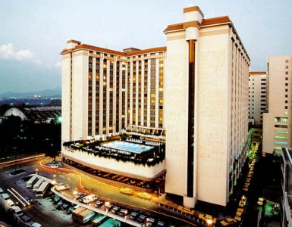
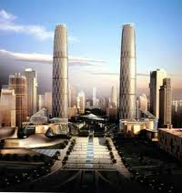
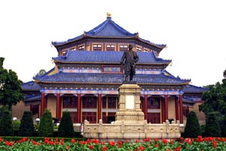
GUANGZHOU
Located in the heart of the Pearl River Delta, Guangzhou is the hub for South China's passenger traffic, logistics, information flow, and capital circulation, the largest regional center in South China, and the core of the Pearl River Delta-South MICE economy industrial zone.
In addition, Guangzhou and its neighbouring areas have rich tourism resources and a good shopping environment, offering a wide range of activities outside business hours.
The Guangzhou Baiyun International Convention Center and the booming top-end hotels make Guangzhou a perfect location for corporate events.
The city has 11 professional exhibition venues. Of these, the Guangzhou International Convention and Exhibition Center is currently Asia's largest venue. We recommend also: The Westin Hotel, China Hotel by Marriott, Sheraton Hotel, The Garden Hotel.

Slide 6
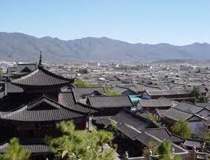
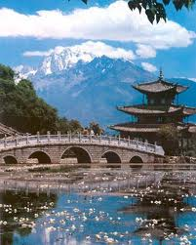
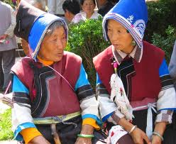
LIJIANG
The Old Town of Lijiang city has eight hundred years of history and it is the best preserved ancient old town in China. It is famous for its orderly system of waterways and bridges. The Old Town of Lijiang continues to maintain the original flavour of the local lifestyle, the typical groups of buildings and the profound cultural heritage of the region. It differs from other ancient Chinese cities in architecture, history and the culture of its traditional residents, the Naxi ethnic minority people.
Lijiang with its rich heritage background and beautiful surroundings creates a great atmosphere for extraordinary events.
The recommended venues in Lijiang are: Crowne Plaza Hotel, Pullman Resort, Treasure Harbour International Hotel.

Slide 7
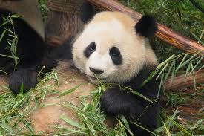
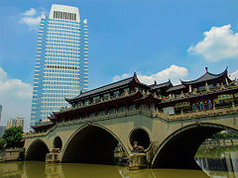
CHENGDU
Chengdu is the capital city of Sichuan province and the home of giant pandas.
In addition to its profound historical and cultural background featuring historic places of interest and natural beauty abounding in surrounding areas, Chengdu also has great events facilities.
Beautiful scenic spots and a wide array of four- and five-star hotels make Chengdu a perfect choice for conventions, meetings, incentive travel, conferences and exhibitions.
Among venues in Chengdu we especially recommend the following: Regal Master Hotel, Wyndham Grand Plaza Royale Palace, Shangri-La Hotel.

Slide 8
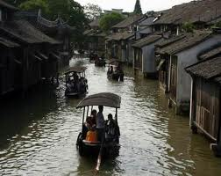
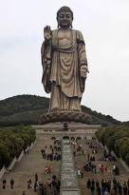
WUXI
Wuxi, located in Jiangsu province, earned its nickname "Pearl of Lake Tai" because it is built on the shore of Lake Tai with beautiful sceneries. As a place of abundance as well as a modern industrial city, Wuxi is also called "Little Shanghai".
Wuxi has a splendid history of over three thousand years. Its scenery combines natural landscape beauty with perfect manmade features. It is a place with rich human culture.
The charming city embraced by clear water and green hills also has a well-developed urban area and hotel industry which provide a good environment for organising events.
The recommended venues are: Doubletree by Hilton Hotel, Millenium Hotel, Sheraton Hotel.

Slide 9
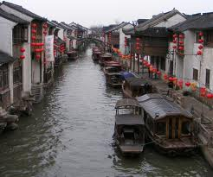
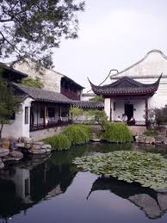
SUZHOU
Suzhou is located on the shores of Taihu Lake in the province of Jiangsu. Since 42% area of the city is covered by water, including a vast number of ponds and streams, Suzhou is praised as the 'Oriental Venice'. The city is renowned for its stone bridges, pagodas, and meticulously designed gardens which have contributed to its status as a great tourist attraction.
It is an ancient city with 2,500 years of history. The unique characteristics of the past are still retained in present-day Suzhou. Strolling the streets, you can feel the unique lingering charm of this landscape left by its long history. Since the times of the Song Dynasty, Suzhou has also been an important centre for China's silk industry and continues to hold that prominent position today.
We recommended following venues: Howard Johnson Jiangsi Garden Resort, Renaissance Hotel, Marriott Hotel.

Slide 10
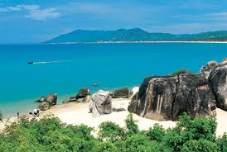
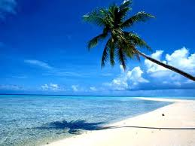
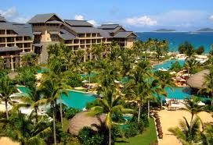
SANYA
Sanya is a city in the southern Hainan province of China called the “Hawaii of the Orient”. It is renowned for its tropical climate and has emerged as a popular tourist destination. Lying in the southernmost tip of Hainan Island China, Sanya is a beachfront tropical city where the mountains, rivers, sea and sky are matched in perfect unison.
While organizing your event, enjoy the beauty of nature in the blending tropical scenes of sunshine, beaches, seawater, coconut palms and rainforest. Bestowed with year-round sunshine, pristine beaches, lush forests, hot springs and a rich, historical culture, Sanya can make a perfect location for an unforgettable event, teambuilding activities, and is a very sought after MICE location.
We recommend Hilton Hotel, Ritz-Carlton Hotel, Doubletree Resort.

